Slide 1

Capstone Preparation Assignment
Mohammad Hilal Malik | Program: FDIT

Slide 2
Assignment Overview
Part 1: How to Pay Attention
Part 2: Three Capstone Proposals
Part 3: Robust Sources & Reflection

Slide 3
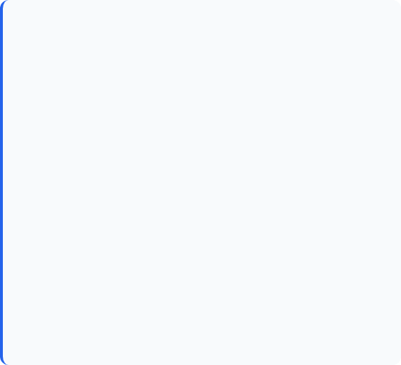
Part 1: Walk with an Expert
Why Selected
How Adapted
As a UI/UX designer, observing someone outside the design field is crucial to challenge assumptions. The goal was to understand how a non-designer thinks, works, and makes decisions.
Instead of observing a UX expert, I sat with a colleague from the Accounts department. This provided an opportunity to observe a workflow completely different from creative design.

Slide 4








Exercise 1: Methodology
Observation
Inquiry
Reflection
Watched their actual workflow including handling requests, approvals, and documentation. Focused on "Show me your real friction."
Prioritized asking "why" over "what" to uncover underlying motivations behind their actions.
Identified where work slowed due to missing info. Noted my own bias to "fix" immediately rather than understand.

Slide 5

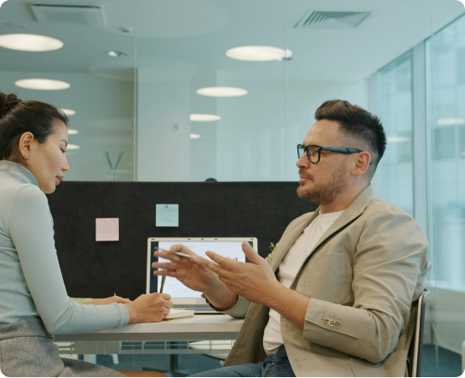
Ex 1: Learnings & Research Connection
Accuracy > Speed: For them, a "good experience" is defined by accuracy and proof, not visual appeal or speed.
Risk Aversion: Their workflow prioritizes reducing risk over convenience.
Root Causes: Issues often occurs from unclear inputs from other teams.

Slide 6
Part 1: Unfamiliar Walk
Why Selected
How Adapted
To practice noticing environment and behaviors like a UX researcher. Understanding how context shapes experience is vital for design.
Compared the familiar (Richmond) with the less familiar (Langley). Intentionally took a transit route via Surrey Central instead of usual route to experience the "first-time user" journey.

Slide 7
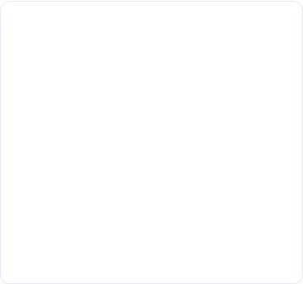
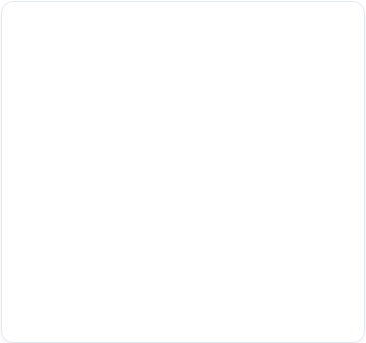
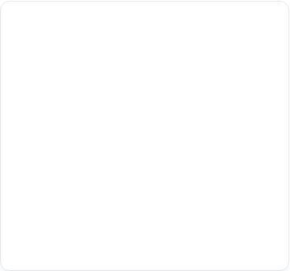





Exercise 2: Methodology
Journey Observation
Field Walk
Comparison
Observed the commute itself: transfers, signage, timing, comfort, and stress points during the transit.
Walked around Langley observing housing, spacing, and walkability factors compared to Richmond.
Reflected on what felt easy vs. confusing, and contrasted people-first vs. car-first environments.

Slide 8
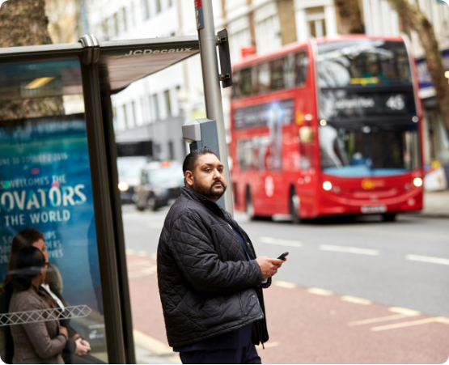
Ex 2: Learnings & Research Connection
Commute is the Journey: The experience isn't just the destination. Small frictions (transfers, timing) erode trust.
Context Friction: Familiar routes hide friction; changing routes reveals stress points.
Research Method: Effectively a Field Observation combined with Journey Mapping—identifying pain points and emotional shifts.

Slide 9
Part 2: Capstone Proposals
Three potential directions for the Capstone project.

Slide 10

Proposal 1: Study Companion
App Concept: The "Study Companion"
A deadline management and smart recall application designed to sync with Moodle, helping working students visualize intense weeks.
Topic: Deadline visibility and reminder & management.
Approach:
H1: Deadline misses increase when work intensity spikes.
H2: Higher-interruption nudges may reduce misses.
Key SMEs:
Kuvan Parhar: Student Counsellor. Insights on stress & support.(kpu alumni)
Shubham Kaniya: Automation Dev. Reminder workflow prototyping.

Slide 11
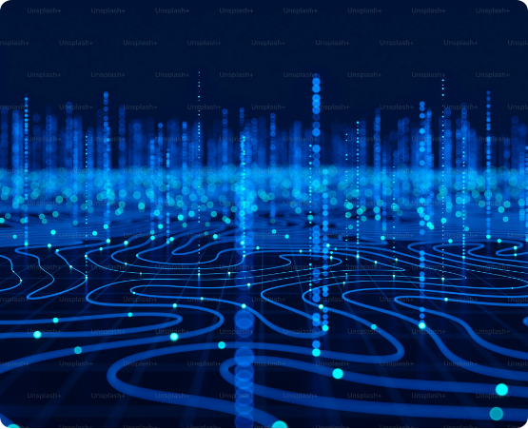
Proposal 2: LLM Debate Workbench
App Concept: The "Debate Workbench"
A web-based research interface that prompts multiple AI models simultaneously, highlighting disagreements to prevent "blind trust" in errors.
Topic: AI-assisted research & trust verification.
Approach:
H1: Multi-model critique reduces error acceptance.
H2: Showing disagreement improves user judgment.
Key SMEs:
Mark Lee (ESDC): AI App Dev. Reliability & accountability.
Divya Sirala (Turing): GenAI Engineer. Evaluation rubrics & bias.
Andres Gaviria: GenAI Dev. Architecture & logging.

Slide 12
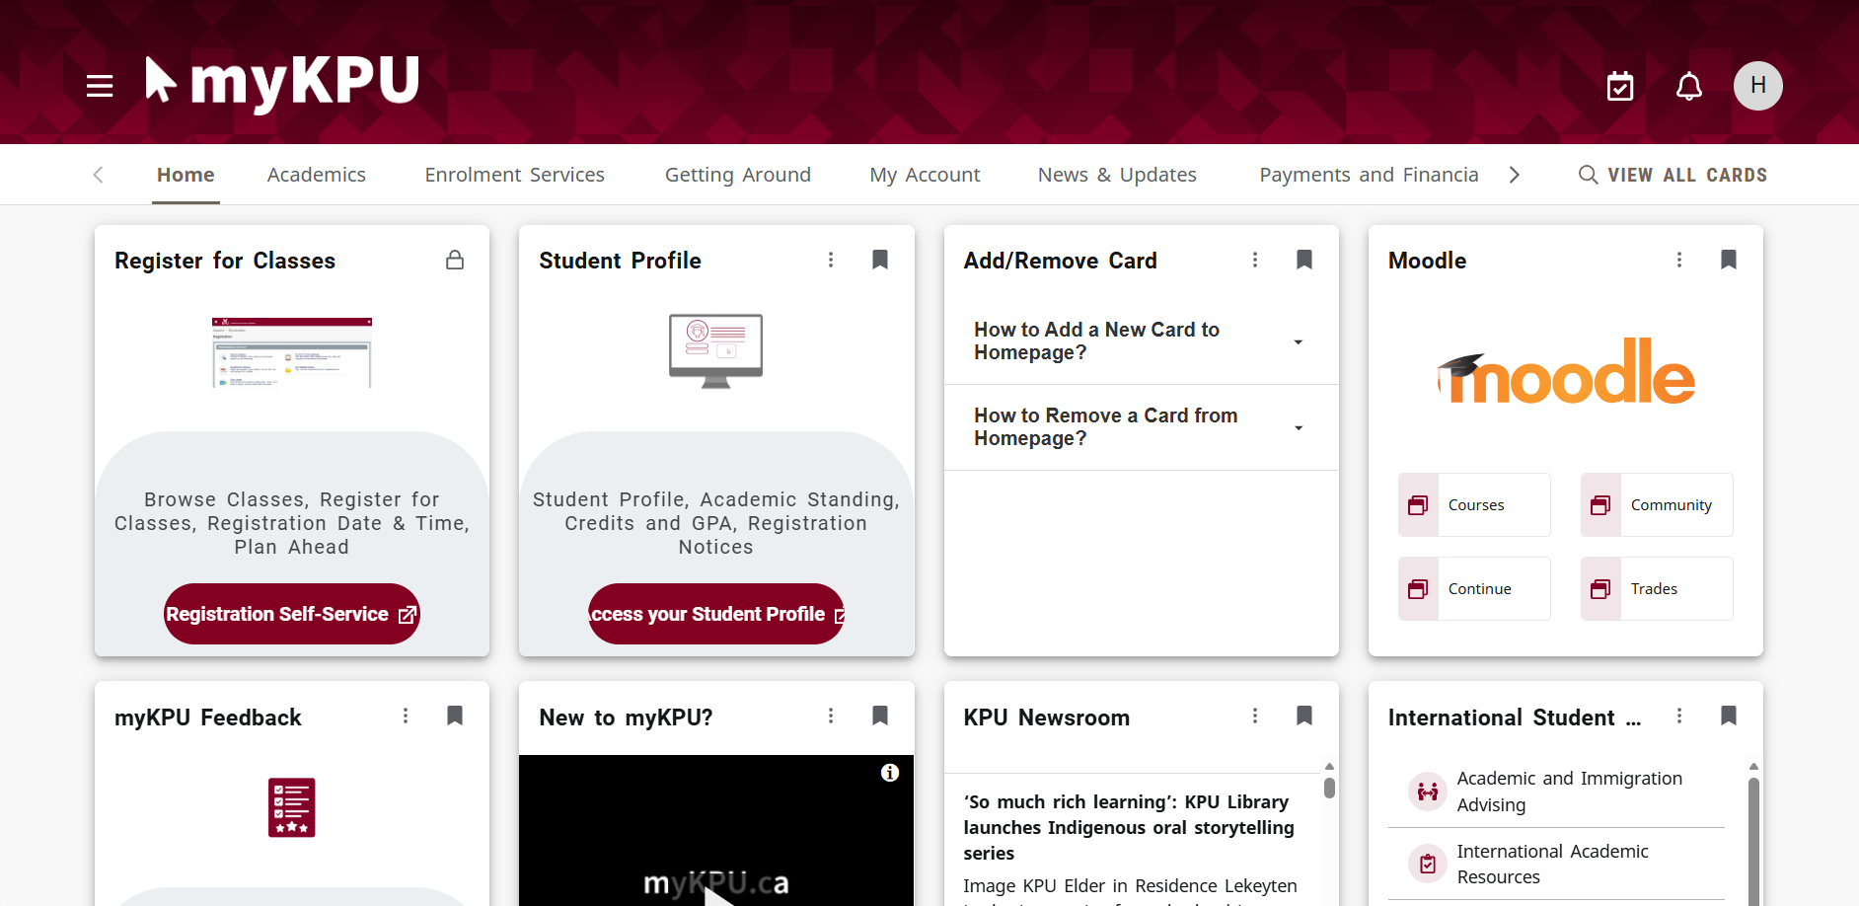
Proposal 3: myKPU Usability
App Concept: "myKPU Redesign"
A streamlined student portal (or mobile companion app) that reorganizes complex dashboards into clear, task-based guided flows.
Topic: Student portal usability.
Approach:
H1: Wayfinding breakdown—students can't match cards to goals.
H2: Visual uniformity creates cognitive overload.
This proposal is what i was not sure about so haven’t yet found SMEs

Slide 13
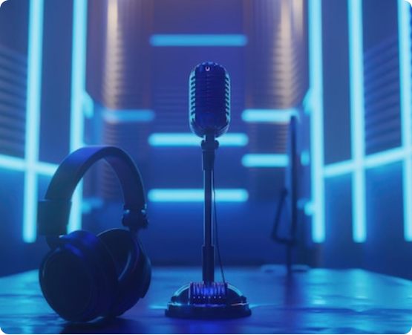
Part 3: Robust Sources
Aravind Srinivas (Perplexity)
Theme: Reliability & Digital Amnesia.
Discusses how Perplexity differs from Google, why answer variance occurs, and the implications of AI on information reliability.
Gaurav Khatri (Noise)
Theme: Product-Market Fit & Bootstrapping.
Focuses on scaling without heavy funding, execution discipline, and building specific products for fast-moving markets.

Slide 14
Summary & Reflection
Current Direction
Question for Instructor
Leaning Toward Proposal 1: Student Companion.
"How broad should my capstone be so it stays research-focused but still testable by spring?"
Key Learning:
Watching real work greatly changed how I define "user experience."
The best lessons came from problems, not from things that worked perfectly.

Slide 15






Image Sources
https://images.unsplash.com/photo-1758691737278-3af15b37af48?fm=jpg&q=60&w=3000&ixlib=rb-4.1.0&ixid=M3wxMjA3fDB8MHxwaG90by1yZWxhdGVkfDE1fHx8ZW58MHx8fHx8
Source: unsplash.com
https://www.worldobesity.org/images/made/images/remote/https_s3-eu-west-1.amazonaws.com/wof-image-bank/Misys_SP2016043861_1200_1800_s_c1.jpg
Source: www.worldobesity.org
https://static.vecteezy.com/system/resources/previews/025/424/111/non_2x/happy-girl-with-laptop-sitting-at-table-young-woman-student-or-freelancer-working-or-studying-on-a-computer-minimalist-style-home-office-online-education-concept-flat-illustration-vector.jpg
Source: www.vecteezy.com
https://plus.unsplash.com/premium_photo-1733267068387-727038c4b62e?fm=jpg&q=60&w=3000&ixlib=rb-4.1.0&ixid=M3wxMjA3fDB8MHxwaG90by1wYWdlfHx8fGVufDB8fHx8fA%3D%3D
Source: unsplash.com
https://static.vecteezy.com/system/resources/thumbnails/071/820/558/small/dynamic-digital-dashboard-displays-complex-data-analytics-financial-charts-and-futuristic-interface-elements-in-a-vibrant-cyan-glow-showcasing-advanced-technology-photo.jpg
Source: www.vecteezy.com
https://img.freepik.com/premium-photo/3d-render-microphone-headphones-audio-studio-desk-with-blue-lighting-full-shot_644874-6910.jpg
Source: www.freepik.com

Slide 16
Questions?
Mohammad Hilal Malik | Program: FDIT
AI Transparency: "I used AI to help structure my notes into a clear presentation format. The observations, examples, and reflections are my own, written in my own words. Any sources suggested by AI were verified.."

